Slide 1
EV Population Analytics Platform on Snowflake
Technical Demo for SI Partner Solutions Engineer Interview
Alan Pérez
From Raw JSON to AI-Ready Insights — Built 100% on Snowflake
Date | Version

Slide 2
Agenda
10 min → Overview / Architecture
20 min → Demo Pipeline
15 min → Semantic Layer + Streamlit
15 min → Q&A

Slide 3
Business Context and Objectives
Washington State has 22,120 registered EVs in this dataset. How do you turn that raw number into business decisions?
Use Case
• Analyze EV adoption patterns from semi-structured population data
• Enable business users to explore trends by state, manufacturer, and vehicle type
• Provide a foundation for governed analytics and AI-driven insights
Objectives
• Build an end-to-end Snowflake-native data pipeline
• Ensure data quality, traceability, and auditability
• Deliver business-ready datasets through a dimensional model
• Enable interactive and conversational analytics

Slide 4
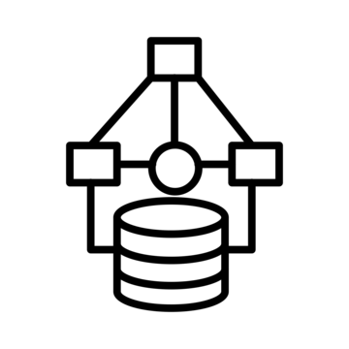

EV ANALYTICS PLATFORM | SNOWFLAKE MEDALLION ARCHITECTURE
Raw Data → Trusted Data → Business Insights → AI Decisions
DATA SOURCES & INGESTION SCOPE
INTEGRATED GOVERNANCE TOOLING
SNOWFLAKE DATA CLOUD (Medallion Architecture Implementation)
Schema Management
Orchestration & Workflow
DevOps
Cataloging
Metadata Management
Discovery & Modeling
INGESTION & DATA MOVEMENT
Bronze
Silver
Gold
CONSUMER INTERFACES
Primary Data Source
RAW DATA
DATA REFINEMENT
BUSINESS ANALYTICS
COLLABORATION SERVICES
Internal Stage
EV Population JSON Dataset (Semi-structured)
Implemented
JSON File Format
Dimensional Model
Analytics & Consumption Layer
JSON Parsing & Flattening / Deduplication
Data Marketplace
Future Data Sources (Planned)
Raw JSON Storage (VARIANT)
Bronze Raw Ingestion
(SQL-based)
Aggregated Business Views
Streamlit App (Interactive Analytics)
Postgres / Relational Sources (CDC or OpenFlow)
Data Typing & Standardization
KPI-ready Datasets
Data Sharing
Semantic Views (Business Layer)
Operational Systems (APIs / Microservices)
Future-Ready Ingestion:
CDC (OpenFlow), Snowpipe, Streams
Source Document Preservation /
Exploded Row-level Data
Data Quality Checks & Reject Handling
Performance-optimized Queries
Batch File Ingestion (CSV, JSON, Parquet)
Conversational Query Interface (Intent-based / AI-ready)
GOVERNANCE & OBSERVABILITY
Pipeline Run Audit
RBAC & Secure Views
Row Count Reconciliation
Data Quality Monitoring (DQ Results & Rejects)
ADVANCED ANALYTICS INTERFACES
Data
Science
Machine Learning / AI
Data Lake
Notes:
“This architecture represents a Snowflake-native implementation of an end-to-end medallion data engineering pipeline built on top of the Electric Vehicle Population JSON dataset. The design is intentionally modular and aligned to separation of concerns: ingestion on the left, progressive refinement in the center through Bronze, Silver, and Gold, governance and observability across all layers, and business-facing consumption on the right. I also included future-ready capabilities, but I clearly separated them from what is actually implemented in the demo.”
1. Data Sources & Ingestion Scope
Primary Data Source
“The main source for this demo is a semi-structured Electric Vehicle Population JSON dataset. I intentionally kept the source simple and realistic, because the purpose of the exercise is not just ingestion, but demonstrating how to transform semi-structured data into a trusted, governed, analytics-ready product inside Snowflake.”
Why this matters
“This dataset is a good fit for Snowflake because it starts as JSON, which lets me demonstrate raw preservation in Bronze, parsing and standardization in Silver, and dimensional analytics in Gold.”
Future Data Sources
“I also show future planned sources such as relational sources through CDC or OpenFlow, operational systems exposed through APIs or microservices, and batch file ingestion formats like CSV, JSON, or Parquet. These are not implemented in this demo, but they illustrate how the same architecture can evolve into a broader enterprise ingestion pattern.”
Why future scope is shown but minimized
“I intentionally did not overload the slide with hypothetical sources. I wanted the architecture to remain honest and implementation-driven, while still showing a clear production evolution path.”
2. Ingestion & Data Movement
Implemented components
“In the implemented ingestion layer, I used three main Snowflake-native components: an internal stage, a JSON file format, and Bronze raw ingestion logic written in SQL.”
Internal Stage
“The internal stage is the landing point for the source JSON file. I used it as the controlled file ingestion entry point into Snowflake.”
JSON File Format
“The JSON file format defines how Snowflake interprets the staged file. In this case, the file contains a root object with metadata and a data array, so the file format remains simple and the transformation logic handles flattening and extraction.”
Bronze Raw Ingestion
“The ingestion logic reads the staged JSON, stores the original source document, and explodes the row-level contents into a raw Bronze table. I labeled it as SQL-based because that is exactly how it is implemented in this demo.”
Design decision
“I chose a Snowflake-native ingestion path because it is transparent, simple to explain, fast to implement, and sufficient for a file-based demo. It also keeps costs and operational complexity low.”
Future-Ready Ingestion
“The note at the bottom identifies future-ready ingestion capabilities such as CDC with OpenFlow, event-driven ingestion with Snowpipe, and incremental logic with Streams. I deliberately kept these as future-state notes rather than central implemented components, because I did not want the architecture to overstate what was actually built.”
3. Bronze Layer
Purpose
“The Bronze layer is the raw preservation layer. Its job is to store the source with maximum fidelity and minimum business interpretation.”
What was implemented
“In Bronze, I implemented two core storage patterns. First, I stored the full source JSON document to preserve the original payload. Second, I stored exploded row-level raw data extracted from the data array of the JSON document.”
Raw JSON Storage (VARIANT)
“The full JSON document is preserved in a VARIANT-based table. This is important because it gives traceability back to the original source and supports replay or reprocessing if the downstream logic changes.”
Source Document Preservation
“This object exists to maintain source fidelity and lineage. If a panel asks how I would troubleshoot parsing issues or prove source-to-target traceability, this is one of the main answers.”
Exploded Row-Level Data
“The second Bronze structure stores each row from the JSON array as a raw row-level record. This is the layer that downstream parsing uses.”
Why Bronze was designed this way
“I intentionally separated full-document preservation from exploded row-level storage because it gives both auditability and practical transformation support. It also reflects a common enterprise pattern: keep the source as-is, then create an operational raw structure for processing.”
Trade-off
“This Bronze implementation is simple and very effective for semi-structured data. If the use case became continuous or event-driven, I would extend Bronze with streaming or incremental ingestion mechanisms, but the raw-preserve principle would remain the same.”
4. Silver Layer
Purpose
“The Silver layer is the trust layer. This is where raw semi-structured data becomes typed, standardized, validated, and deduplicated.”
What was implemented
“In Silver, I parsed the positional JSON array fields into explicit business columns, applied data typing, standardized text fields, implemented deduplication logic, and persisted data quality handling results.”
JSON Parsing and Flattening
“The source JSON is not already a clean object-per-row structure. It contains a data array where each row is positional. In Silver, I mapped those positions into named business attributes such as vehicle identifier, geography, make, model, model year, EV type, range, and price-related fields.”
Data Typing
“I used safe typing functions such as TRY_TO_NUMBER so the transformation would not fail if the source contained unexpected or malformed values. This is a practical design choice that prioritizes resilience.”
Standardization
“I applied standardization rules like trimming whitespace and uppercasing selected fields to make downstream analytics more consistent.”
Deduplication
“I implemented deduplication using business-key logic with ROW_NUMBER. The primary key candidate is DOL Vehicle ID, and I also designed the logic to support fallback behavior where needed. This ensures that the Silver layer is not just parsed, but also logically cleaned.”
Data Quality Checks and Reject Handling
“Silver is also where I enforced quality expectations such as null checks, validity checks, and record handling for bad data. Rather than silently dropping problematic records, I preserved them in rejects for transparency.”
Why Silver was designed this way
“I wanted Silver to be the boundary between raw source fidelity and trusted consumption. It centralizes transformation and quality logic so that Gold can stay focused on business analytics.”
Trade-off
“I chose SQL-based transformations rather than Snowpark or dbt for this demo because SQL is fully sufficient for the workload, highly explainable in a panel interview, and keeps the solution Snowflake-native. In production, I would consider dbt for lifecycle management and Snowpark for more complex procedural logic.”
5. Gold Layer
Purpose
“The Gold layer is the business analytics layer. Its purpose is to convert trusted refined data into reusable analytical structures.”
What was implemented
“In Gold, I built a dimensional model with fact and dimension tables, and then created aggregate structures to support reporting, KPIs, and semantic consumption.”
Dimensional Model
“The dimensional model includes conformed structures for location, make/model, and EV type, as well as a fact table for EV registrations. This allows business-friendly analysis without exposing raw transformation logic.”
Aggregated Business Views
“On top of the fact and dimensions, I created aggregate structures such as state/year summaries, make-level summaries, and EV type summaries. These support immediate business analysis.”
KPI-Ready Datasets
“I then exposed Gold views that are already organized for KPI-style questions, such as adoption trends, top manufacturers, state performance, and EV type insights.”
Performance-Optimized Queries
“By pushing aggregation and business logic into the Gold layer, I reduce the burden on downstream consumers and improve consistency across reporting and semantic use cases.”
Why Gold was designed this way
“I did not want business users, dashboards, or AI-facing layers to query Silver directly. Gold creates a stable, analytics-oriented contract.”
Trade-off
“I kept Gold intentionally simple but robust. I did not overcomplicate it with every possible dimension, because the goal was to optimize for explainability and demo value while still showing proper dimensional thinking.”
6. Collaboration Services
Purpose
“This area represents how Gold data is safely exposed for collaboration and downstream access.”
What was implemented
“In the demo, I implemented secure views for controlled exposure of curated business datasets, and I prepared the architecture for governed sharing.”
Data Sharing
“I created a dedicated sharing layer with secure views instead of exposing base Gold tables directly. This improves governance and reduces coupling.”
Why this matters
“This is important because it shows that the solution is not only about transformation, but also about how data products are safely consumed.”
Data Marketplace
“The marketplace concept is shown in the template as an enterprise collaboration pattern, but in this specific demo, the implemented collaboration focus is secure data sharing through Snowflake-native secure views.”
Trade-off
“I intentionally did not build a full cross-account share setup for the demo, because secure views already demonstrate the correct design pattern and are enough to explain how governed sharing would work.”
7. Governance & Observability
Purpose
“This is one of the strongest parts of the architecture because it shows that the solution is operationally trustworthy, not just analytically useful.”
Pipeline Run Audit
“I created pipeline run audit structures to record execution-level metadata and create an operational history of runs.”
RBAC & Secure Views
“I included RBAC and secure views as governance mechanisms for controlled access and consumer isolation.”
Row Count Reconciliation
“I implemented reconciliation across Bronze, Silver, and Gold to validate that row movement across layers is explainable.”
Data Quality Monitoring
“I also persisted data quality monitoring results, including DQ results and rejects. This allows me to distinguish between trusted and problematic records in a transparent way.”
Why this matters
“I wanted quality, auditability, and observability to be first-class architectural concerns. That is especially important in a panel like this, because it shows production thinking.”
Trade-off
“This level of monitoring is enough for a demo and highly valuable to explain. In production, I would extend this with alerting integrations and richer operational dashboards.”
8. Consumer Interfaces
Purpose
“This layer represents how business and technical consumers interact with the governed output of the platform.”
Analytics & Consumption Layer
“I added an explicit consumption layer because I wanted to separate analytical use from transformation logic.”
Streamlit App
“The primary implemented consumer is a Streamlit app running inside Snowflake. It provides executive KPIs, trend analysis, drill-down exploration, and a lightweight conversational experience.”
Semantic Views
“I also created semantic-ready views so consumers work with business-friendly naming rather than technical structures.”
Conversational Query Interface
“The conversational query interface is implemented as an intent-based, AI-ready experience. For the demo, I used controlled query routing instead of a fully auto-generated semantic model. That gave me more control over the metric definitions and behavior.”
Why this matters
“This right side of the architecture is where the technical work translates into business value.”
9. Integrated Governance Tooling
Purpose
“The top row represents enterprise capabilities that support broader platform maturity.”
How to explain it honestly
“In this demo, not every box in this top row is fully implemented as a standalone toolset. Instead, it represents enterprise-aligned concerns such as schema management, orchestration, DevOps, cataloging, metadata management, and semantic discovery.”
What you can say if asked
“If asked, I would explain that the demo partially implements orchestration, metadata awareness, and semantic design, while the remaining areas represent how this architecture would integrate into a more complete enterprise operating model.”
10. Advanced Analytics Interfaces
Purpose
“The bottom section shows where the architecture could evolve for broader analytical workloads.”
How to explain it
“For this demo, the implemented analytical consumer is the Streamlit app and semantic layer. The advanced analytics row indicates that the same governed data foundation could be extended to data science, machine learning, or lakehouse interoperability scenarios.”
Important honesty point
“I would not overstate this section. I would explicitly say it represents extension potential rather than implemented deliverables.”

Slide 6
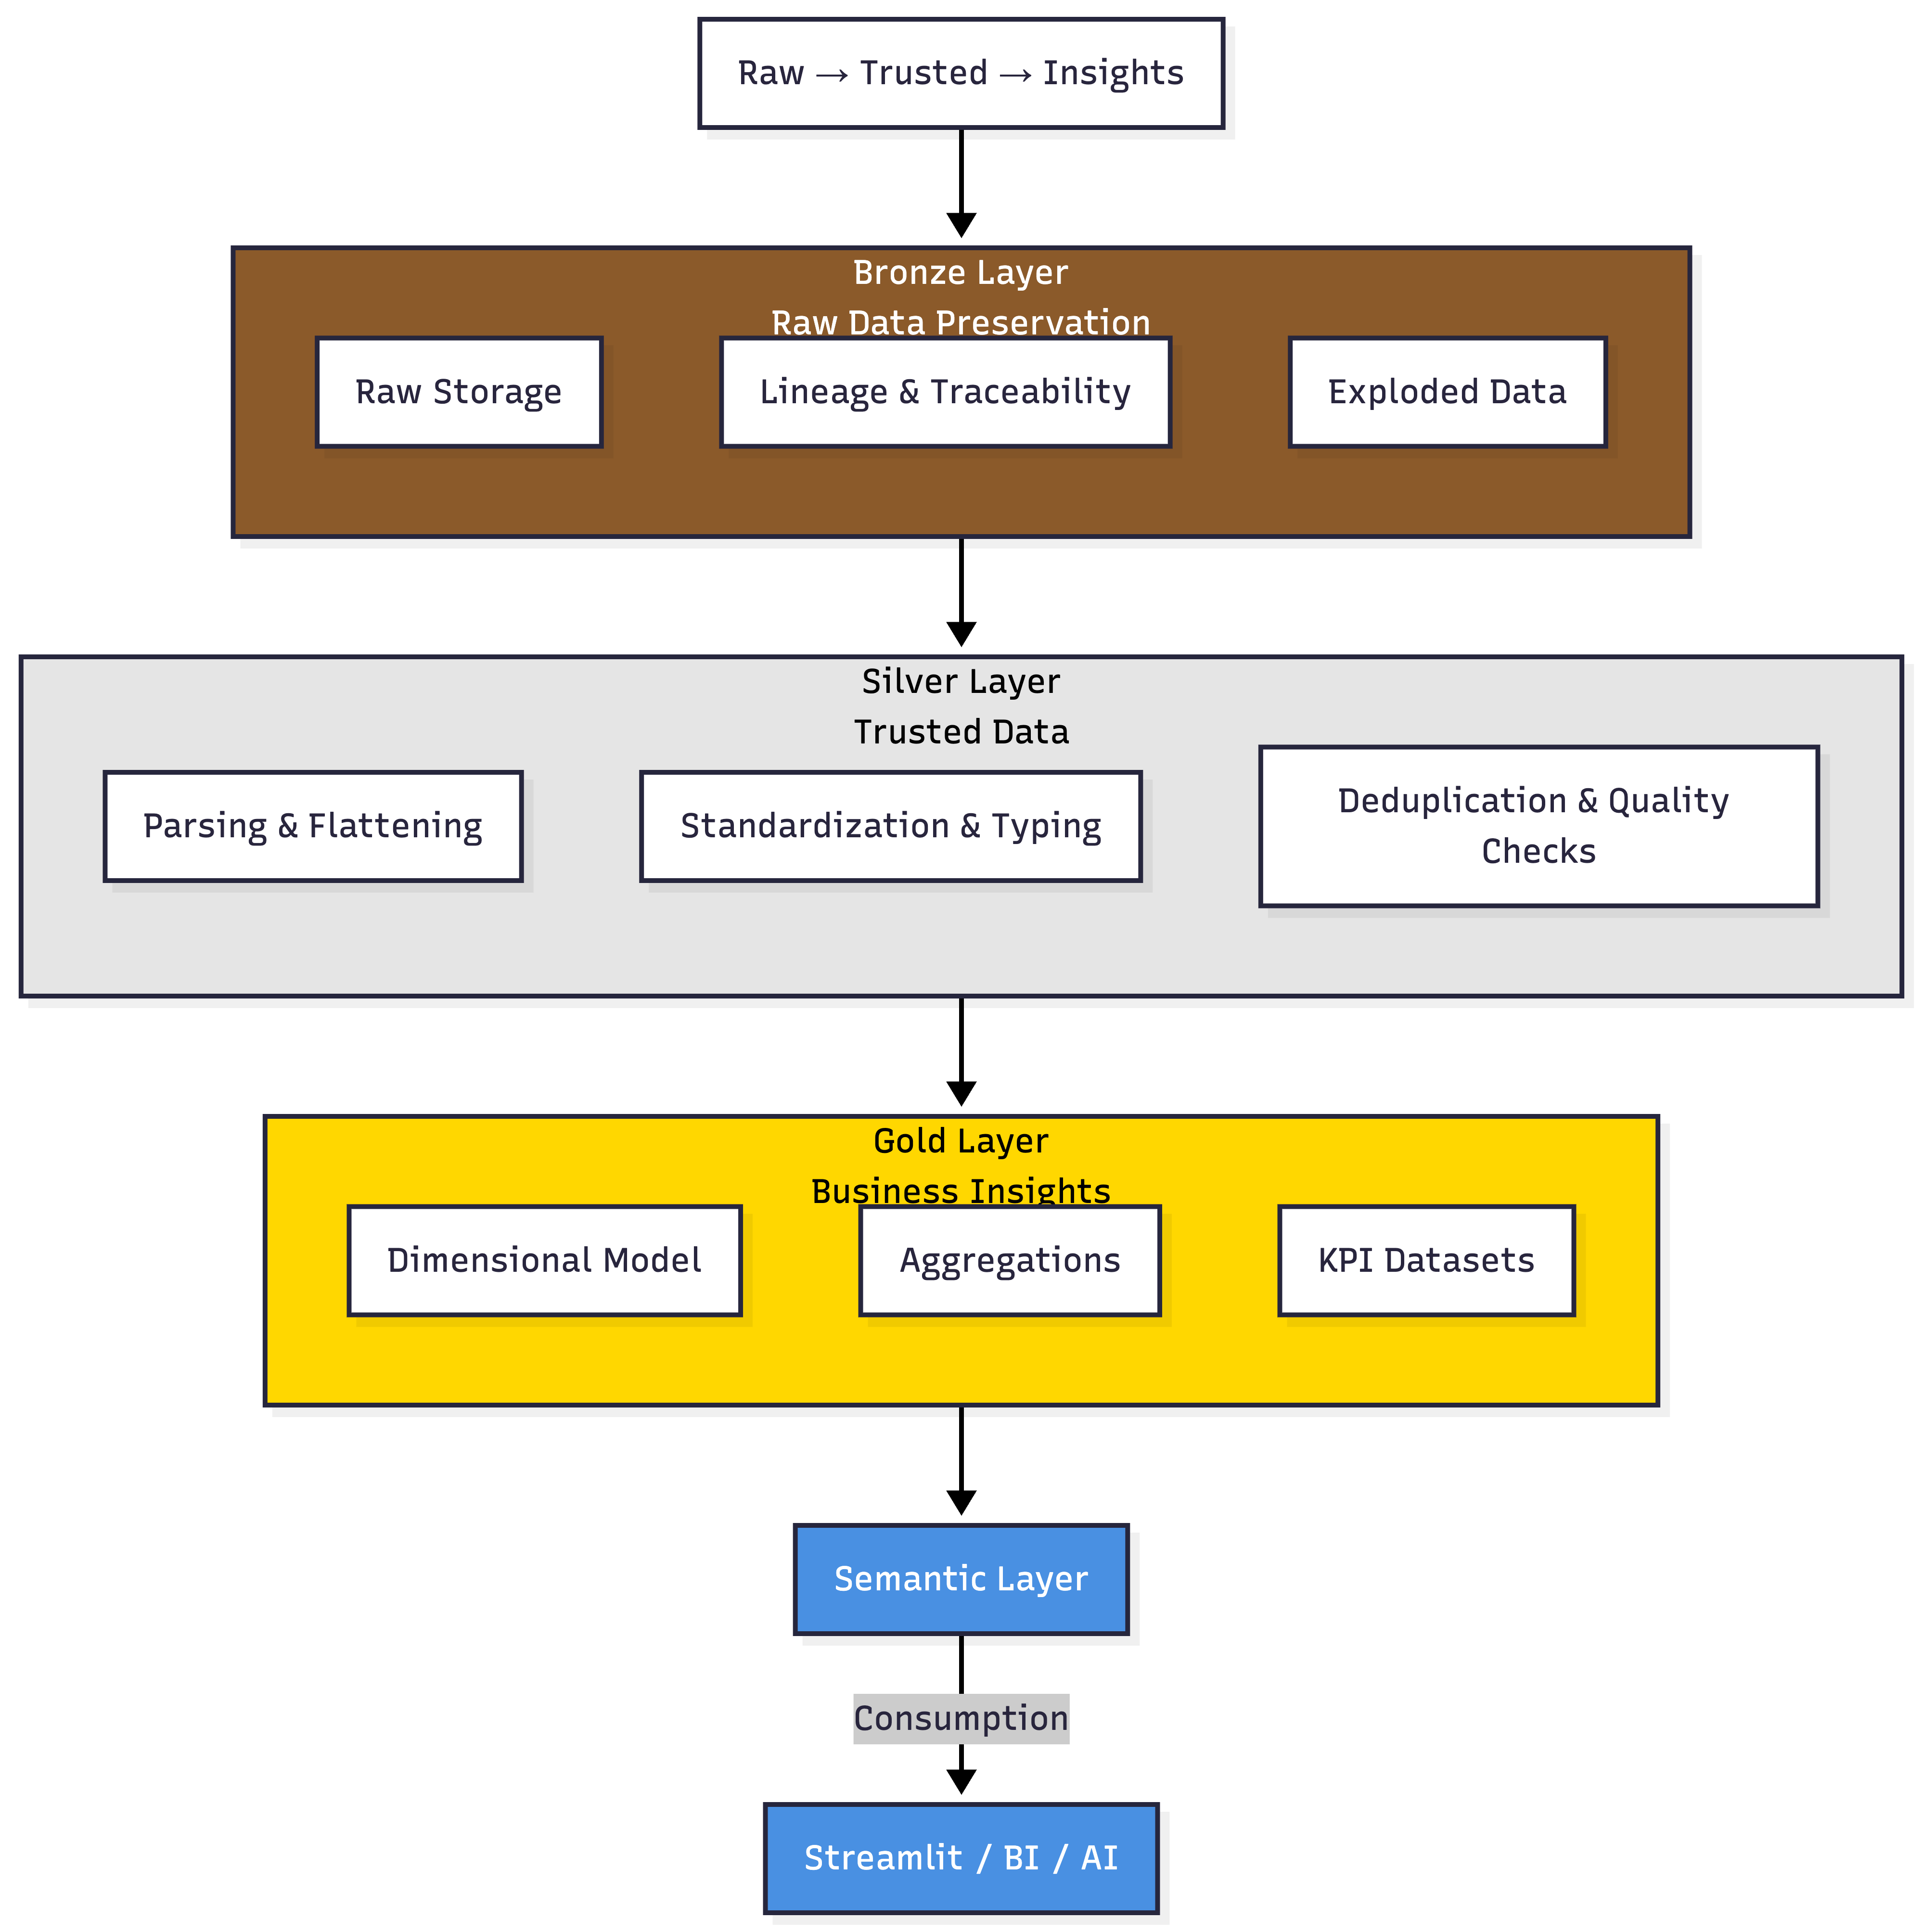
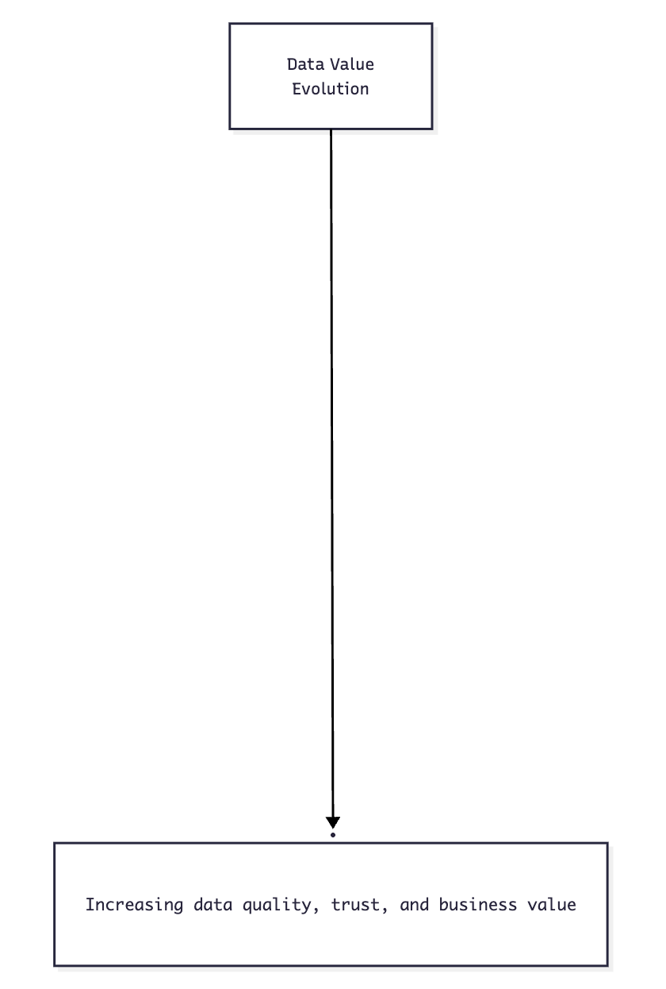
Medallion Architecture Design
Notes:
This diagram illustrates how data evolves across the medallion architecture.
We start with raw ingestion, where JSON data is stored in its original form in the Bronze layer. At this stage, the focus is on preserving data fidelity, lineage, and traceability, while also preparing exploded row-level records for downstream processing.
In the Silver layer, the focus shifts to data trust and quality. Here, I parse and flatten the semi-structured data, apply typing and standardization, and implement deduplication and data quality checks to ensure the dataset is reliable.
Finally, in the Gold layer, the data is transformed into business value. I build a dimensional model, create aggregated business views, and expose KPI-ready analytical datasets optimized for performance.
On top of that, I introduce a semantic layer that abstracts the complexity and enables consumption through Streamlit, BI tools, and AI-driven interfaces.
Overall, the goal of this design is to clearly separate raw data, trusted data, and business-ready insights.

Slide 7
Data Quality, Governance, and Observability
Raw Data → Trusted Data → Business Insights → AI Decisions
Data Quality | • Completeness, validity, and uniqueness checks • Explicit reject handling for invalid records • Data quality results stored for transparency
Observability | • Pipeline run audit tracking • Row-count reconciliation across layers • Monitoring of data movement and transformations
Governance | • RBAC-based access control • Secure views for controlled data exposure • Separation between technical and business layers
Notes:
Iceberg was intentionally left as a deployment template because Snowflake-managed Iceberg requires an external volume backed by real cloud storage and environment-level Azure configuration, which was outside the scope of the trial-only demo

Slide 8
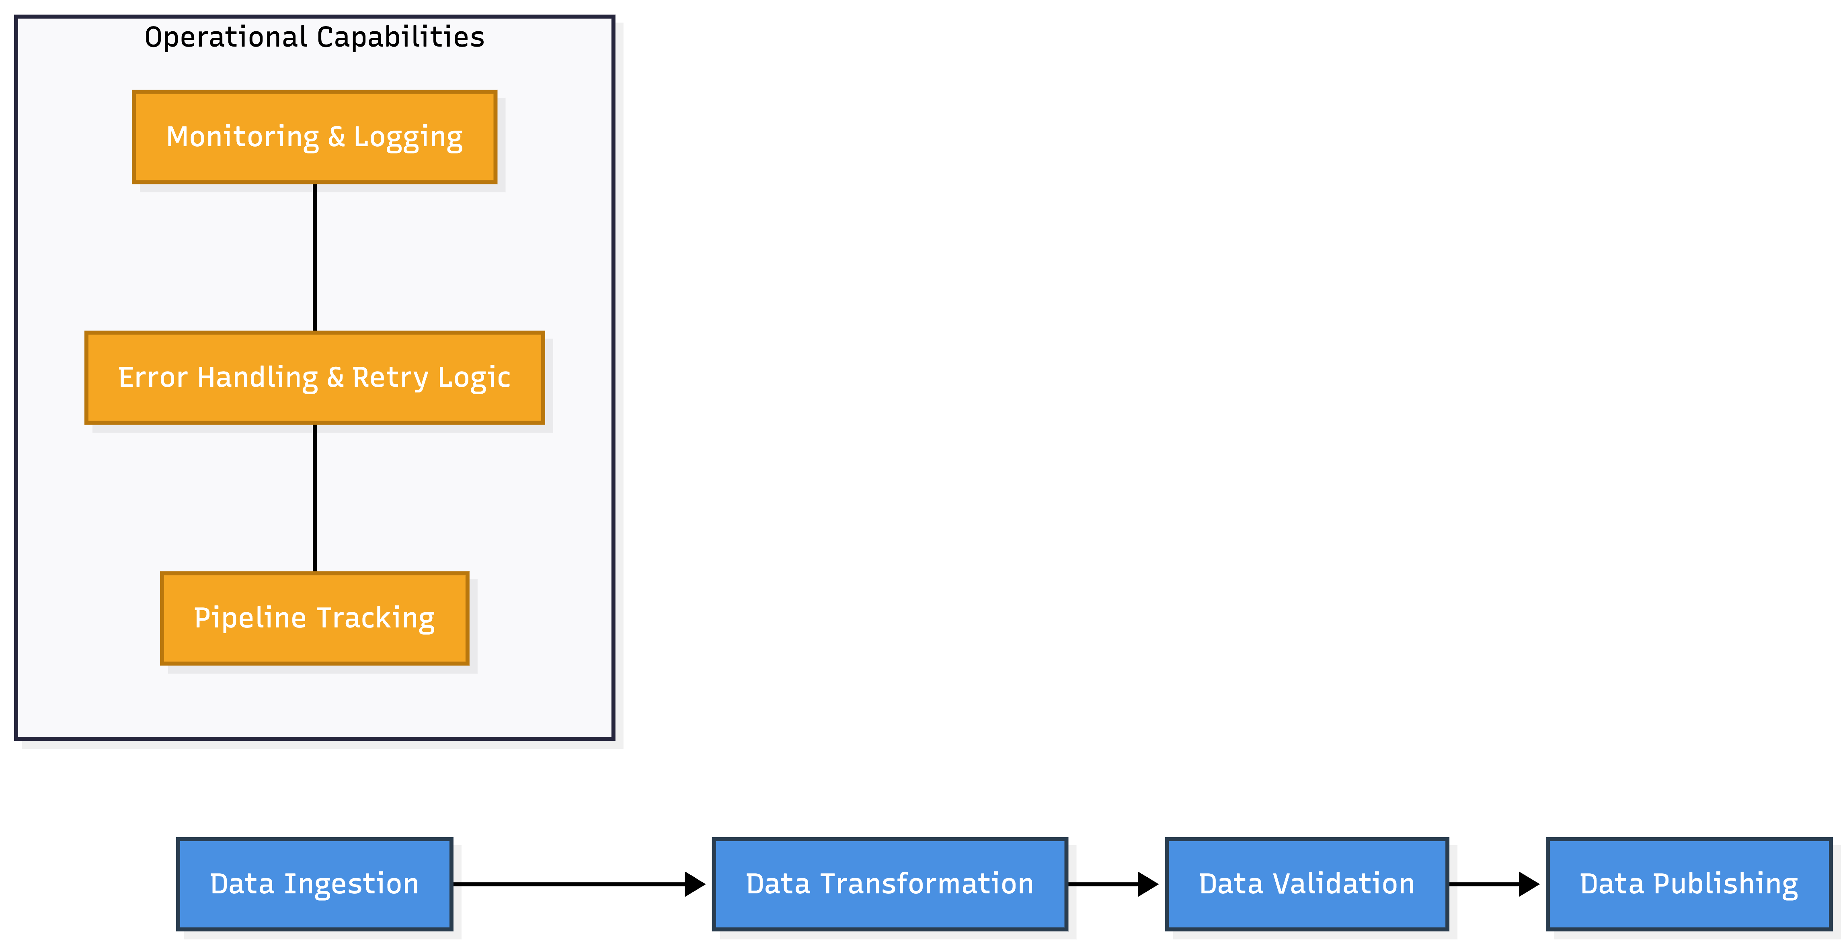
Orchestration and Operational Design
Raw Data → Trusted Data → Business Insights → AI Decisions
Notes:
For this demo, I prioritized transparency and modularity, while leaving a clear path for production-grade orchestration.

Slide 9
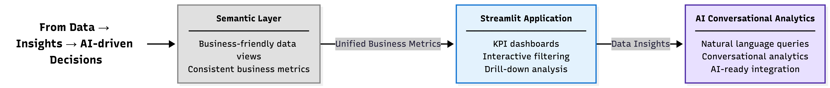
AI-Ready Semantic Layer and Interactive Analytics
Raw Data → Trusted Data → Business Insights → AI Decisions
Notes:
For this demo, I prioritized transparency and modularity, while leaving a clear path for production-grade orchestration.

Slide 10
Data Quality, Governance, and Observability
Data Quality | • Completeness, validity, and uniqueness checks • Explicit reject handling for invalid records • Data quality results stored for transparency
Observability | • Pipeline run audit tracking • Row-count reconciliation across layers • Monitoring of data movement and transformations
Governance | • RBAC-based access control • Secure views for controlled data exposure • Separation between technical and business layers

Slide 11
Trade-offs, Alternatives, and Design Decisions
Raw Data → Trusted Data → Business Insights → AI Decisions
Design Choices
• Snowflake-native SQL over external frameworks
• Medallion architecture for clarity and scalability
• Secure views for governance
Alternatives Considered
• dbt for transformation lifecycle management
• Snowpark for advanced transformations
• Iceberg for open table interoperability
• CDC-based ingestion with OpenFlow
Trade-offs
• Simplicity vs extensibility
• Faster implementation vs full enterprise tooling
• Controlled design vs auto-generated semantic models
Notes:
For this demo, I prioritized transparency and modularity, while leaving a clear path for production-grade orchestration.

Slide 12
Business Value and Demo Overview
Raw Data → Trusted Data → Business Insights → AI Decisions
Business Value
• Faster insight generation from semi-structured data
• Trusted and governed analytics layer
• Reusable and scalable architecture
• AI-ready data foundation
Demo Overview
• Pipeline walkthrough (Bronze → Silver → Gold)
• Data quality and monitoring
• Business analytics and Streamlit app
• Conversational queries
Notes:
For this demo, I prioritized transparency and modularity, while leaving a clear path for production-grade orchestration.

Slide 13
SNOWCASE | DATA INTEGRATION REFERENCE ARCHITECTURE
INTEGRATED GOVERNANCE TOOLING
DATA SOURCES
DISTRIBUTION SERVICES
SNOWFLAKE DATA CLOUD
DATA CONSUMPTION
Schema Management
Orchestration & Workflow
DevOps
Cataloging
Metadata Management
Discovery & Modeling
Business Applications
Source Interfaces
Business Intelligence
RFC
SAP Business Suite
Reports
ODP Framework
INGEST INTERFACES
RAW
CONFORMED
CONSUMPTION
CONSUMER INTERFACES
SAP BW
LANDING ZONE
TRANSFORMATION SERVICES
DATA ACCESS SERVICES
COLLABORATION SERVICES
Dashboards
SAP HANA
Service Bus & Event Processing
JDBC
ODBC
Applications
Relational Data Sources
SAP BO Data Services
Streams & Tasks
Materialised Views
Data Marketplace
Data Marketplace
SAP LT Replication Server
Copy Into
Structured Data
Secure Views
Snowsight
Data Exchange
MSSQL
SAP Data Intelligence
External Functions
JDBC
Mobile Apps
Oracle
External Tables
Data Sharing
Semi-structured
Data
Stored Procedures
ODBC
IBM DB2
File
Zero Copy Clone
File
GOVERNANCE
Modern Data Sources
AWS S3 Bucket
AWS S3 Bucket
Web Services, JMS, XML
Audit
RBAC
Metadata
Obfuscation / Redcation
Cloud Storage
Microsoft Azure Blob
ADVANCED ANALYTICS INTERFACES
Microsoft Azure Blob
Files / Unstructured Data
Data
Science
Machine Learning / AI
Data Lake
GCS
GCS

